Slide 1
[Computer Architecture Fundamentals and Concepts]
[Computer Architecture and Operating Systems]
Lecture [2]
[Foundation of Computer Architectures]
This lecture and its associated materials have been produced by [Bikash Bhattarai and MBA] of iAcademy for the purposes of lecturing on the above described subject and the material should be viewed in this context. The work does not constitute professional advice and no warranties are made regarding the information presented. The Author and iAcademy do not accept any liability for the consequences of any action taken as a result of the work or any recommendations made or inferred. Permission to use any of these materials must be first granted by iAcademy.

Slide 2
Agenda
Week 2 Lecture Coverage
  Foundations for computer architectures
  Digital logics
  Types of memories
  Processor organizations

Slide 3
Learning Objectives
On successful completion of this lecture, students will be able to demonstrate:
  digital logics, memory and processor organization

Slide 4
Review of Week 1 (1)
From first week we should have understood:
  Computer architecture functions and concepts
  History of computer architectures
  Forces on computer architectures
  Usages and future of computer of computer architectures

Slide 5
Review of Week 1 (2)
What are the four functions of computer systems?
Give one example for each generation of computers
How can operating system play important role in computer architecture ?

Slide 6

Q&A ?
Coursework Submission

Slide 7
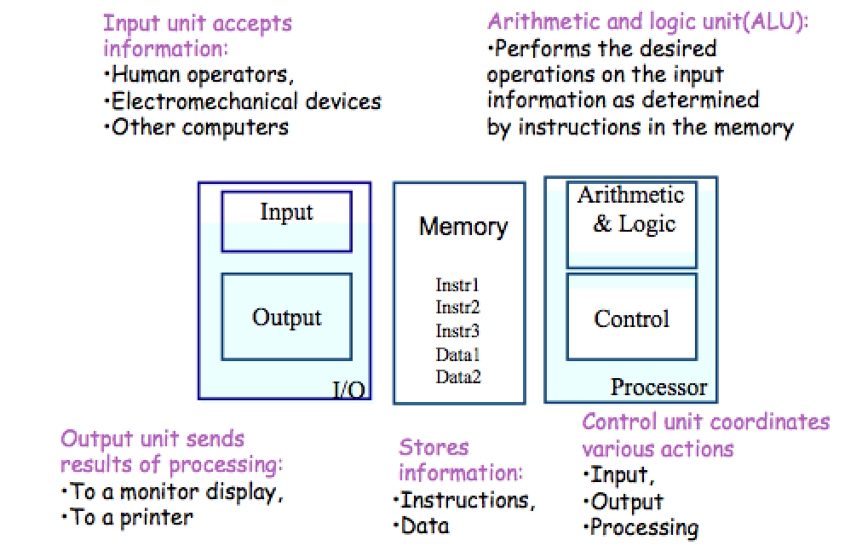
Foundations for computer architectures

Slide 8
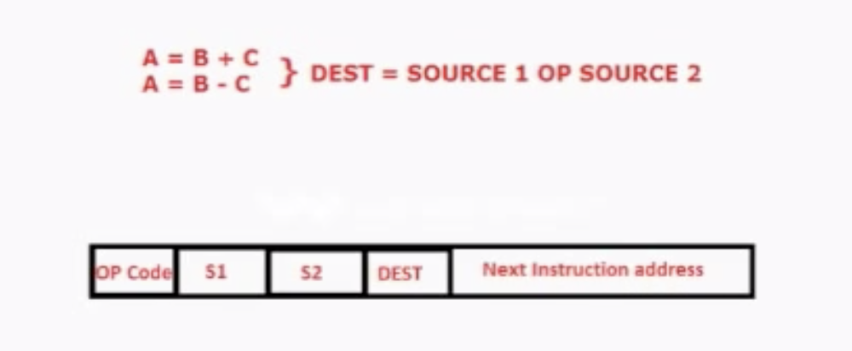
Foundations for computer architectures
Instructions
    - It is a single operation of a processor defined by instruction sets.
    - A sequence of instructions to perform a task is called a program, which is stored in the memory.
    - Processor fetches instructions that make up a program from the memory and performs the operations stated in those instructions.

Slide 9
Foundations for computer architectures
Instructions
      Transfer information within a computer (e.g., from memory to ALU)
      Transfer of information between the computer and I/O devices (e.g., from keyboard to computer, or computer to printer)
      Perform arithmetic and logic operations (e.g., Add two numbers, Perform a logical AND).

Slide 10
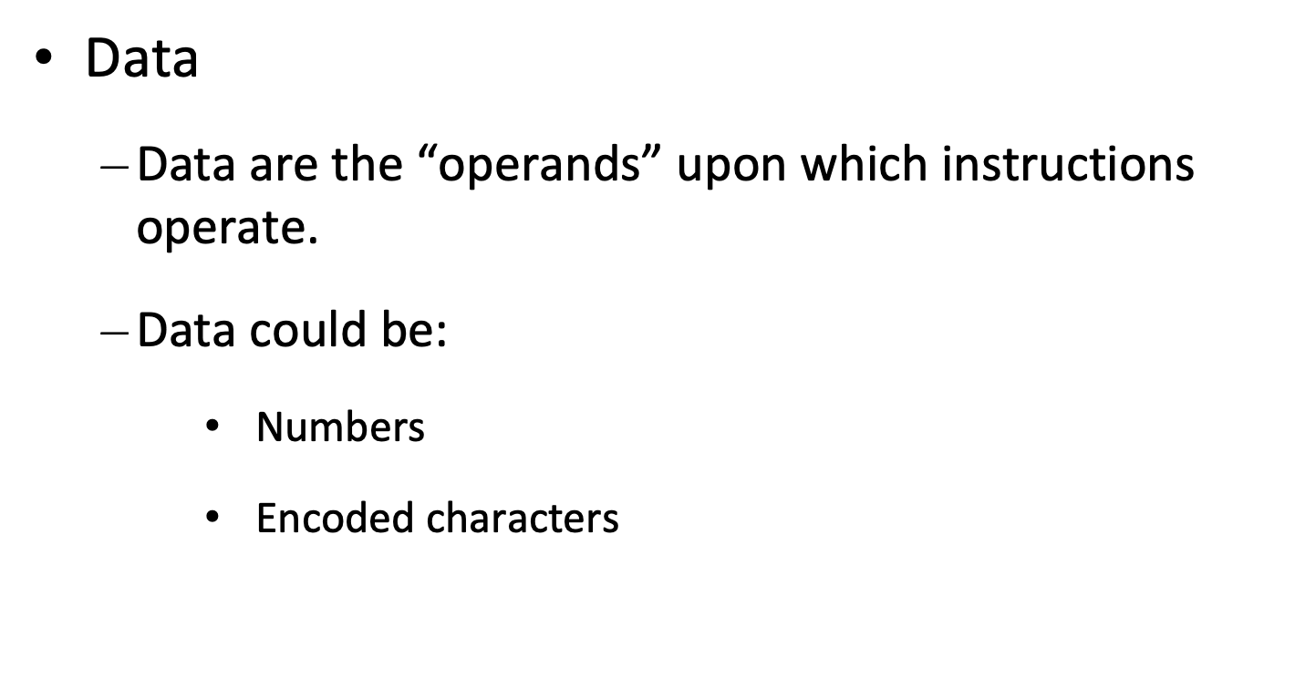
Foundations for computer architectures

Slide 11
Foundations for computer architectures
Instructions (Programs)
Operands (DATA)
Data
      Data, in a broad sense means any digital information.
      Computers use data that is encoded as a string of binary digits called bits.

Slide 12
Foundations for computer architectures
Input Unit
      Binary information must be presented to a computer in a specific format. This task is performed by the input unit: (1)
        Interfaces with input devices.
        Accepts binary information from the input devices.

Slide 13
Foundations for computer architectures
      Binary information must be presented to a computer in a specific format. This task is performed by the input unit: (2)
        Presents this binary information in a format expected by the computer.
        Transfers this information to the processor

Slide 14
Foundations for computer architectures
Arithmetic Logic Unit (ALU) (1)
  Operations are executed in the Arithmetic and Logic Unit (ALU).
    Arithmetic operations such as addition, subtraction.
    Logic operations such as comparison of numbers.

Slide 15
Foundations for computer architectures
Arithmetic Logic Unit (ALU) (2)
  In order to execute an instruction, operands need to be brought into the ALU from the memory.
    Operands are stored in general purpose registers available in the ALU.
    Access times of general purpose registers are faster than the cache.
  Results of the operations are stored back in the memory or retained in the processor for immediate use.

Slide 16
Foundations for computer architectures
Output Unit
  Computers represent information in a specific binary form. Output units:
    Interface with output devices.
    Accept processed results provided by the computer in specific binary form.
    Convert the information in binary form to a form understood by an output device
    Printer, Display, Speaker etc.

Slide 17
Foundations for computer architectures
Control Unit (1)
  Operation of a computer can be summarized as:
    Accepts information from the input devices (Input unit).
    Stores the information (Memory).
    Processes the information (ALU).
    Provides processed results through the output devices(Output unit).

Slide 18
Foundations for computer architectures
Control Unit (2)
  Operations of Input unit, Memory, ALU and Output unit are coordinated by Control unit.
  Instructions control “what” operations take place (e.g. data transfer, processing).
  Control unit generates timing signals which determines “when” a particular operation takes place.

Slide 19
Digital Logics
Logic 1 or 0
  Logic 1
    Yes, On, Mark, True, High
  Logic 0
    No, Off, Space, False, Low

Slide 20
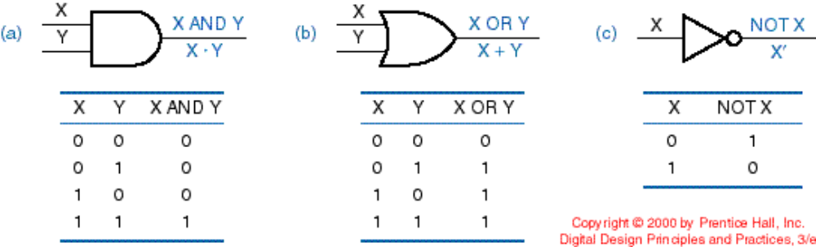
Digital Logics
Basic Digital Logic Gates (AND, OR, NOT)

Slide 21
Types of Memories
Memory Types
  Registers
  Random Access Memory (RAM)
  Read Only Memory
  Flash Memory

Slide 22
Types of Memories
Registers
  Top in the hierarchy
  one of a small set of data holding places
  Accumulator(AC), Data Register(DR), Address Register(AR), Program Counter(PC), Memory Data Register (MDR), Index Register(IR), Memory Buffer Register(MBR) But are large and consume significant power
  consist of a small amount of fast storage

Slide 23
Types of Memories
Random Access Memory (RAM)
the memory cells can be accessed for information transfer from any desired random location. That is, the process of locating a word in memory is the same and requires an equal amount of time no matter where the cells are located physically in memory.
Volatile memory
  Types of RAM:
    Static RAM (SRAM)
    Dynamic RAM (DRAM)

Slide 24
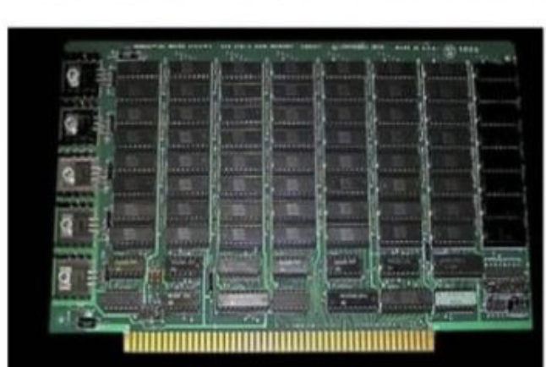
Types of Memories
Static RAM
  Static RAM (SRAM) based on flip flops
  Contents of each location persist as long as power is applied.
  Fast but relatively large
  Consume a lot of power
  Used for memory applications that are small but fast

Slide 25
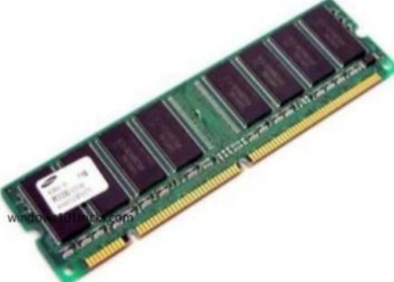
Types of Memories
Dynamic RAM
  Dynamic RAM (DRAM) employ capacitors
  Capacitor stores electric charge whose level represents a 1 or 0
  Capacitors dissipate with time and hence the charge must be restored frequently
  DRAMs are Smaller, slower than SRAMs
  Support low cost, low power and high density and hence used in main memory

Slide 26
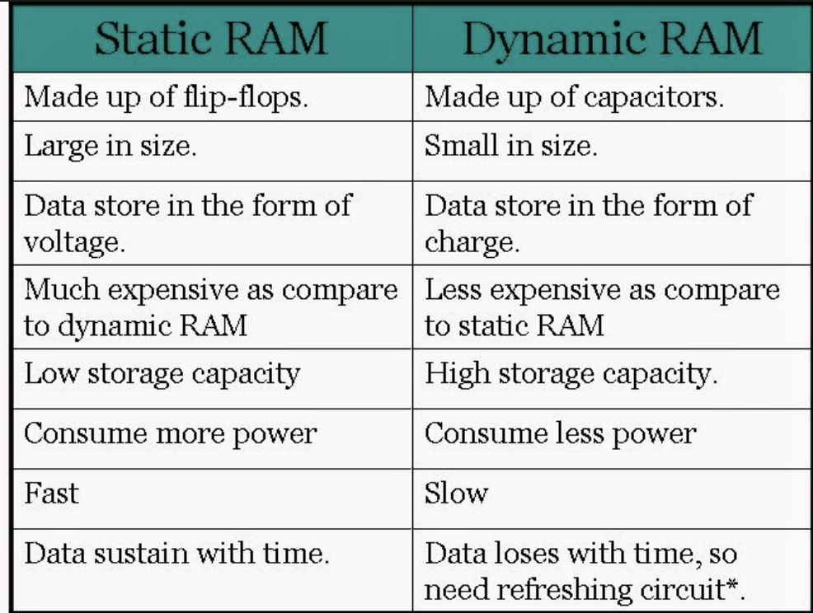

Slide 27
Types of Memories
Read Only Memory (ROM)
  Data stored in these chips is nonvolatile -- it is not lost when power is turned off.
  On turn on, the computer loads BIOS from ROM
  Data stored in these chips is either unchangeable or requires a special operation to change
  Applications: Operating sytems,Videogames, calculators, microwave oven, etc.

Slide 28
Types of Memories
Read Only Memory (ROM)
  Programmable Read-Only Memory (PROM) burner allows contents of the ROM to be overwritten only once.(Mobile Phones for providing User Specific Selections, Implantable Medical devices.)
  Erasable Programmable Read-Only Memory(EPROM) – could be written several times (BIOS chips)
Electrically Erasable Programmable Read-Only Memory (EEPROM) – allow the content to be rewritten electrically . (As storage for re-programmable calibration information in test-equipment.)

Slide 29
Types of Memories
Flash Memory
  A section of memory cells can be erased in a single step, or 'flash', thus the name
  Nonvolatile memory
  Flash memory is used for easy and fast information storage in such devices as digital cameras, pendrives, video game consoles

Slide 30
Q&A ?

Slide 31
Summary (1)
Components of Computer System
  Input and Output Systems
  Memory
  Processor
    ALU
    Control
Digital Logics
  Concept of 0 and 1
  Gates

Slide 32
Summary (2)
Memory Types
  Registers
  Random Access Memory (RAM)
  Red Only Memory
  Flash Memory

Slide 33
Workshop
Group of 4-5 students prepare basic computer architecture
Form a group
Students need to come prepared with different computer components and their organizations

Slide 34


